Slide 1

INSTITUTE: UIE (AIT-CSE)
Computer Networks CST- 348
Lecture - 1.3,1.4
data transmission,network topologies
By : Dr. Monica Luthra(e9836)
DISCOVER . LEARN . EMPOWER

Slide 2

Course Objectives
CO Number | Title
CO1 | Describe the important networking concepts
CO2 | Understand concept of network reference models and protocols
CO3 | Apply the concepts of routing algorithms on various networks
CO4 | Identify mechanism to handle traffic and control on congestion
CO5 | Identify and understand connection establishment techniques and features

Slide 3

Course Outcomes
After this course student will be able to:
To bring together several key of Computer network design and architecture
To Familiarize the student with the basic taxonomy and terminology of the computer networking area.
To Allow the student to gain expertise in some specific areas of networking such as the design and maintenance of individual networks.

Slide 4

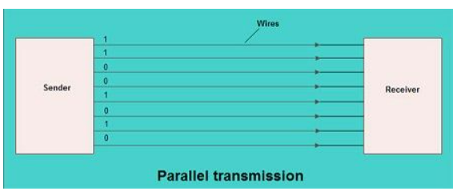
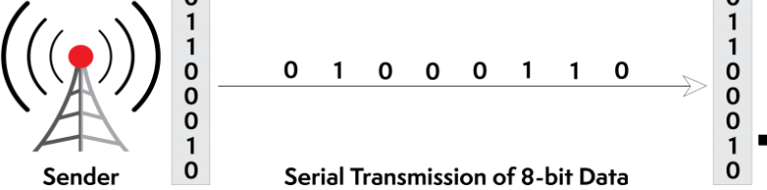
Data Transmission types
Parallel Transmission
All the bits of data are transmitted simultaneously on separate communication lines
In order to submit n bits, n wires or lines are used. Thus each bit has its own line.
2. Serial Transmission
The various bits of data are transmitted serially one after the other.
It requires only one communication line .
All the bits are transmitted on single line in serial fashion.

Slide 5
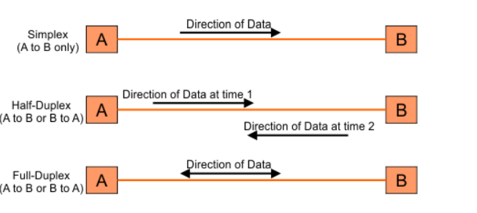
Transmission Modes
Simplex Mode
Half duplex Mode
Full duplex Mode

Slide 6
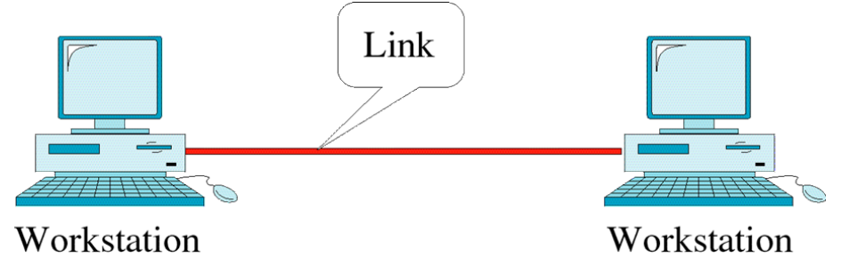
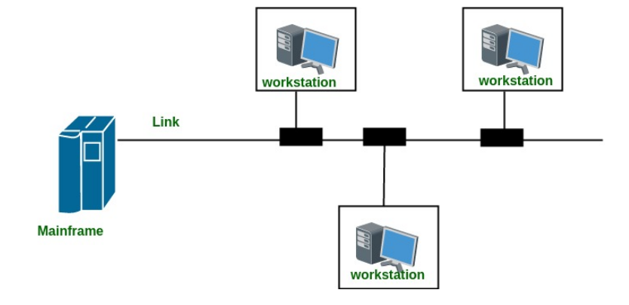
Line Configuration
POINT TO POINT
MULTIPOINT

Slide 7
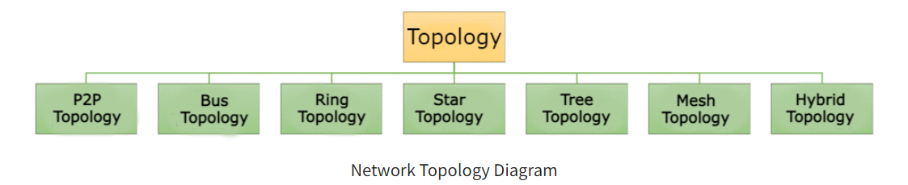
Topologies
A Network Topology is the arrangement with which computer systems or network devices are connected to each other. Topologies may define both physical and logical aspect of the network. Both logical and physical topologies could be same or different in a same network.

Slide 8
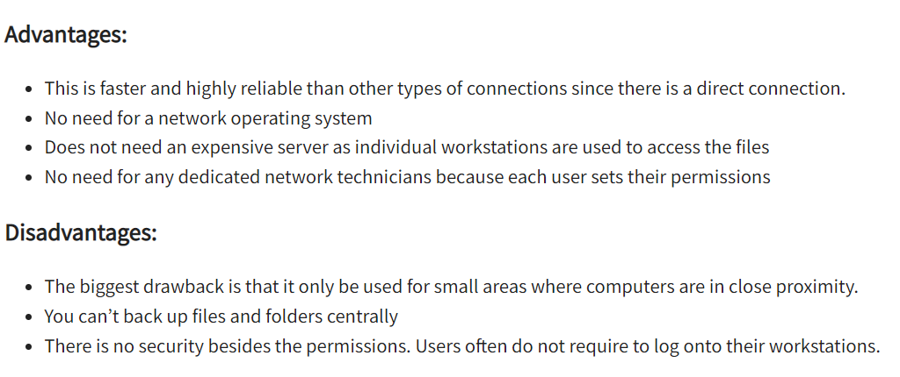
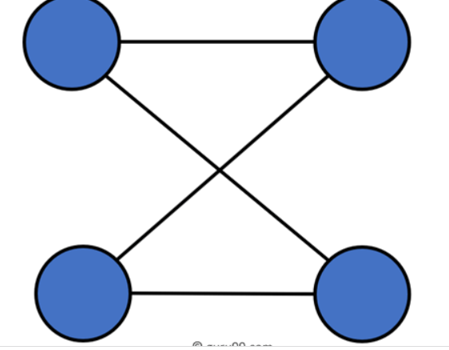
TYPES OF TOPOLOGIES
Point to Point (P2P)
Point-to-point topology is the easiest of all the network topologies. In this method, the network consists of a direct link between two computers.

Slide 9
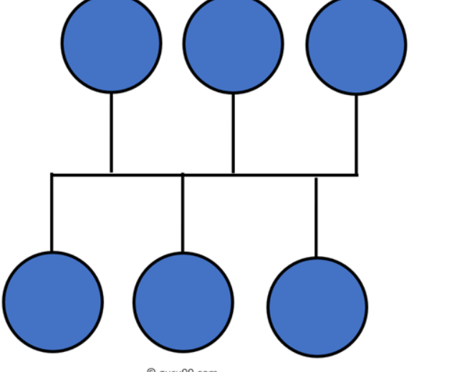
Bus Topology
Advantages:
Here are pros/benefits of using a bus topology:
Cost of the cable is very less as compared to other topology, so it is widely used to build small networks.
Famous for LAN network because they are inexpensive and easy to install.
It is widely used when a network installation is small, simple, or temporary.
It is one of the passive topologies. So computers on the bus only listen for data being sent, that are not responsible for moving the data from one computer to others.
Disadvantages:
Here are the cons/drawbacks of bus topology:
In case if the common cable fails, then the entire system will crash down.
When network traffic is heavy, it develops collisions in the network.
Whenever network traffic is heavy, or nodes are too many, the performance time of the network significantly decreases.
Cables are always of a limited length.

Slide 10
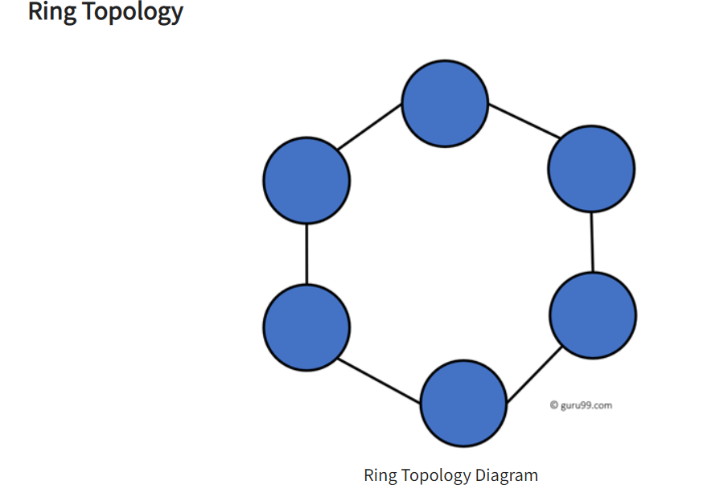
In a ring network, every device has exactly two neighboring devices for communication purpose. It is called a ring topology as its formation is like a ring. In this topology, every computer is connected to another computer. Here, the last node is combined with a first one.
Disadvantages:
Unidirectional traffic.
Break in a single ring can risk the breaking of the entire network
Modern days high-speed LANs made this topology less popular.
In the ring, topology signals are circulating at all times, which develops unwanted power consumption.
It is very difficult to troubleshoot the ring network.
Adding or removing the computers can disturb the network activity.
Advantages:
Easy to install and reconfigure.
Adding or deleting a device in-ring topology needs you to move only two connections.
The troubleshooting process is difficult in a ring topology.
Offers equal access to all the computers of the networks
Faster error checking and acknowledgment.

Slide 11
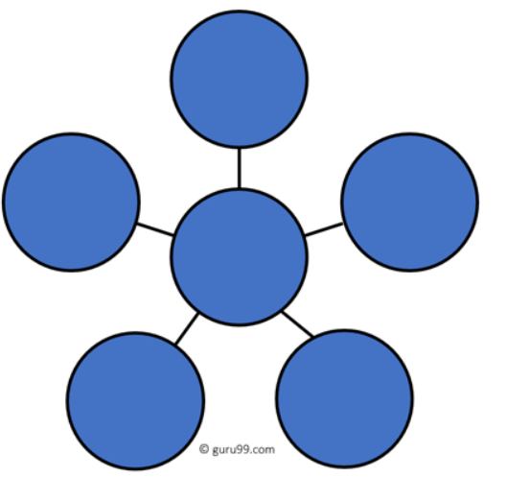
Star Topology
In the star topology, all the computers connect with the help of a hub. This cable is called a central node, and all other nodes are connected using this central node. It is most popular on LAN networks as they are inexpensive and easy to install.
Advantages:
Easy to troubleshoot, set up, and modify.
Only those nodes are affected, that has failed. Other nodes still work.
Fast performance with few nodes and very low network traffic.
In Star topology, addition, deletion, and moving of the devices are easy.
Disadvantages:
If the hub or concentrator fails, attached nodes are disabled.
Cost of installation of star topology is costly.
Heavy network traffic can sometimes slow the bus considerably.
Performance depends on the hub’s capacity
A damaged cable or lack of proper termination may bring the network down.

Slide 12
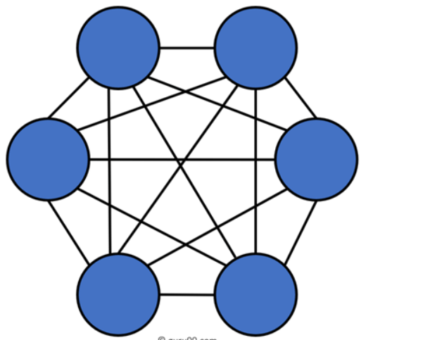
Mesh Topology
The mesh topology has a unique network design in which each computer on the network connects to every other. It is develops a P2P (point-to-point) connection between all the devices of the network. It offers a high level of redundancy, so even if one network cable fails, still data has an alternative path to reach its destination. every nodes or device are directly connected.
Disadvantages:
Installation is complex because every node is connected to every node.
It is expensive due to the use of more cables. No proper utilization of systems.
Complicated implementation.
It requires more space for dedicated links.
Because of the amount of cabling and the number of input-outputs, it is expensive to implement.
It requires a large space to run the cables.
ted with each other.

Slide 13
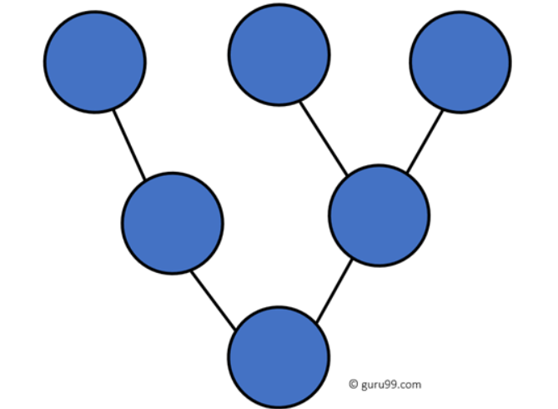
Tree Topology
Tree topologies have a root node, and all other nodes are connected which form a hierarchy. So it is also known as hierarchical topology. This topology integrates various star topologies together in a single bus, so it is known as a Star Bus topology. Tree topology is a very common network which is similar to a bus and star topology.
Advantages:
Failure of one node never affects the rest of the network.
Node expansion is fast and easy.
Detection of error is an easy process
It is easy to manage and maintain
Disadvantages:
It is heavily cabled topology
If more nodes are added, then its maintenance is difficult
If the hub or concentrator fails, attached nodes are also disabled.

Slide 14
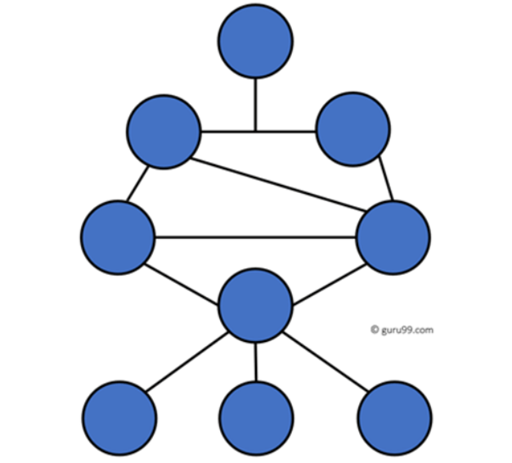
Hybrid Topology
Hybrid topology combines two or more topologies. You can see in the above architecture in such a manner that the resulting network does not exhibit one of the standard topologies.
For example, as you can see in the above image that in an office in one department, Star and P2P topology is used. A hybrid topology is always produced when two different basic network topologies are connected.
Advantages:
Offers the easiest method for error detecting and troubleshooting
Highly effective and flexible networking topology
It is scalable so you can increase your network size
Disadvantages:
The design of hybrid topology is complex
It is one of the costliest processes

Slide 15
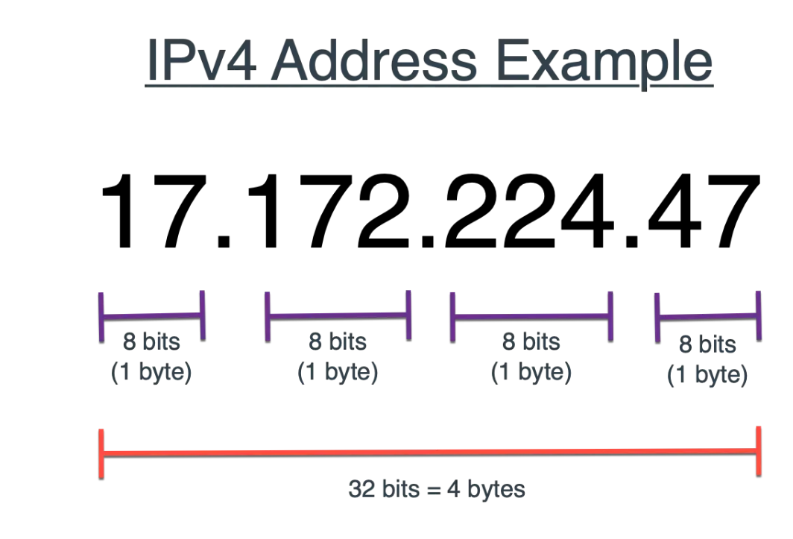
IPV4 Addressing

Slide 16
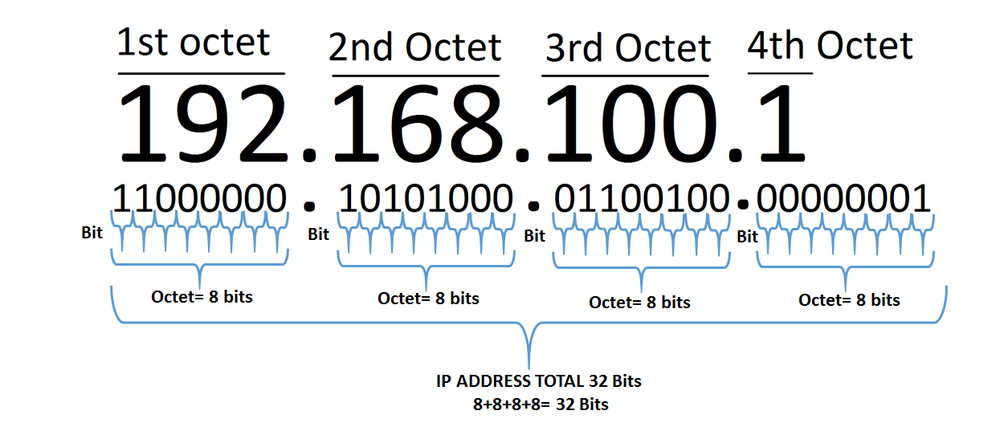
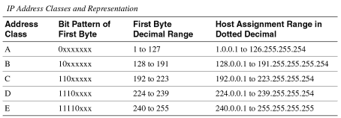
IPv4 Addressing
Image Source : https://en.wikipedia.org/wiki/IPv6

Slide 17
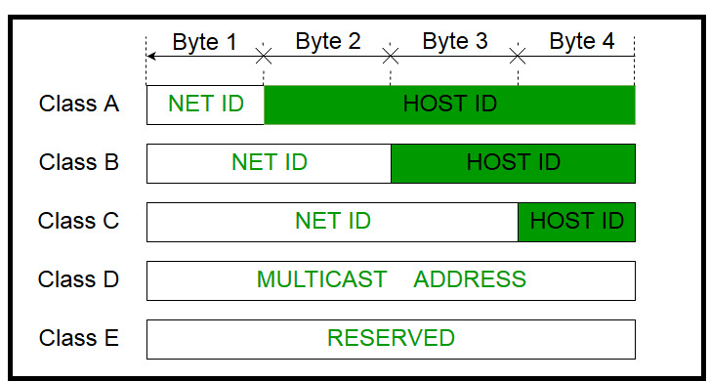
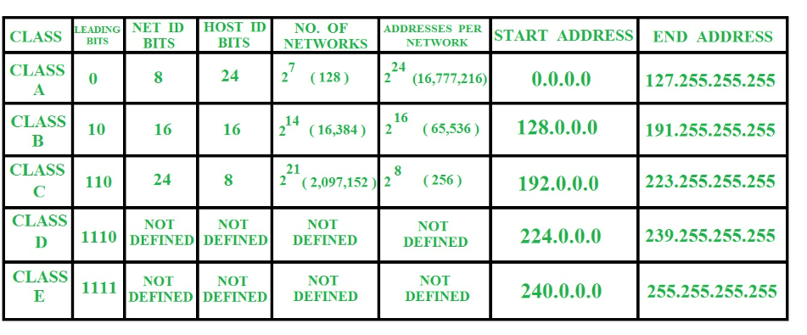
IPv4 Addressing

Slide 18
Key Points
Data communications are the transfer of data from one device to another via some form of transmission medium.
A data communications system must transmit data to the correct destination in an
accurate and timely manner.
Text, numbers, images, audio, and video are different forms of information.
Data flow between two devices can occur in one of three ways: simplex, half-duplex, or full-duplex.
In a point-to-point connection, two and only two devices are connected by a
dedicated link. In a multipoint connection, three or more devices share a link.
Topology refers to the physical or logical arrangement of a network. Devices may be arranged in a mesh, star, bus, or ring topology.
A network can be categorized as a local area network or a wide area network.
There are local, regional, national, and international Internet service providers.
A protocol is a set of rules that govern data communication; the key elements of a protocol are syntax, semantics, and timing

Slide 19
References
https://www.geeksforgeeks.org/basics-computer-networking/
https://www.youtube.com/watch?v=VwN91x5i25g&list=PLBlnK6fEyqRgMCUAG0XRw78UA8qnv6jEx
http://www.svecw.edu.in/Docs%5CCSECNLNotes2013.pdf
https://www.cloudflare.com/learning/ddos/glossary/open-systems-interconnection-model-osi/

Slide 20
THANK YOU
For queries
Email: monica.e9836@cumail.in

